Slide 1






Training on Lexical Resources
Kenneth Church, Xingyu Cai, Yuchen Bian
Baidu, Sunnyvale, USA

Slide 2
URLs: https://github.com/kwchurch
Syn_ant: https://github.com/kwchurch/syn_ant
Closely follows this paper
ACL2022_deepnets_tutorial: https://github.com/kwchurch/ACL2022_deepnets_tutorial
Part A: Glass is Half-Full
Deep Nets can do much
Part B: Glass is Half-Empty
There is always more to do
gft: https://github.com/kwchurch/gft
General Fine-Tuning: A Little Language for Deep Nets
Code (plus hundreds of examples)

Slide 3
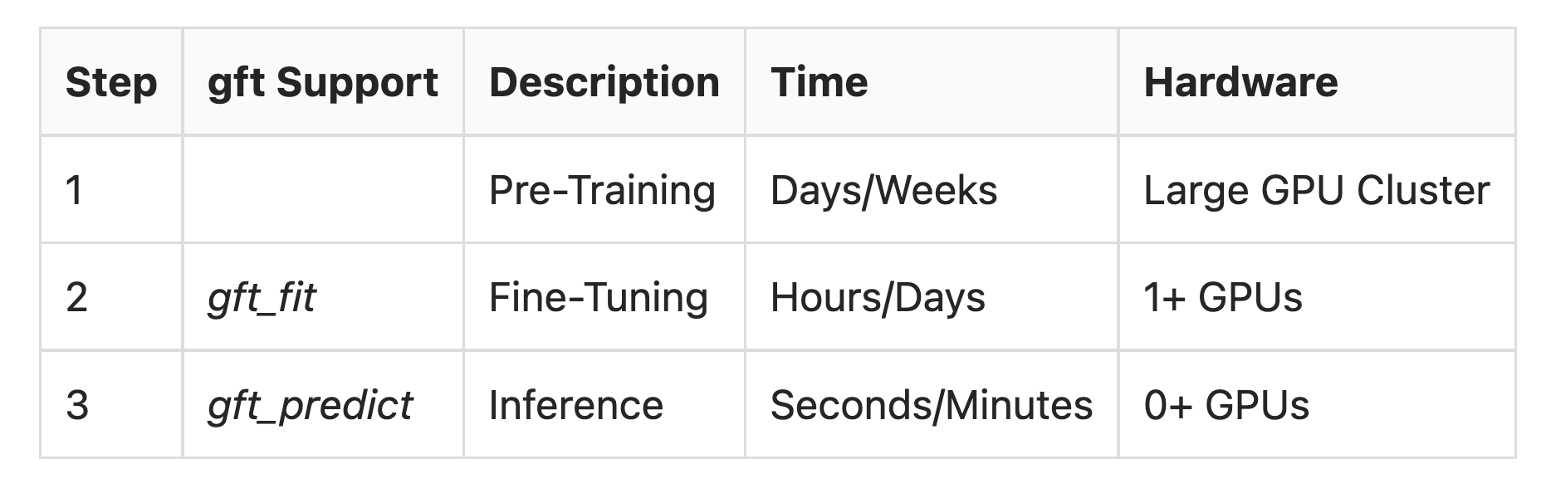
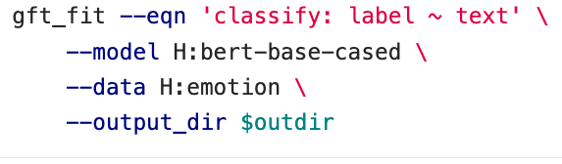
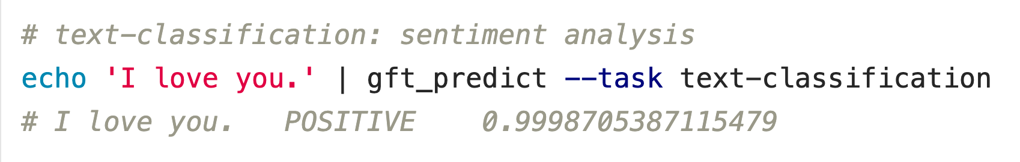

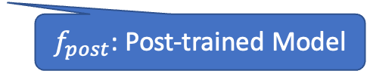
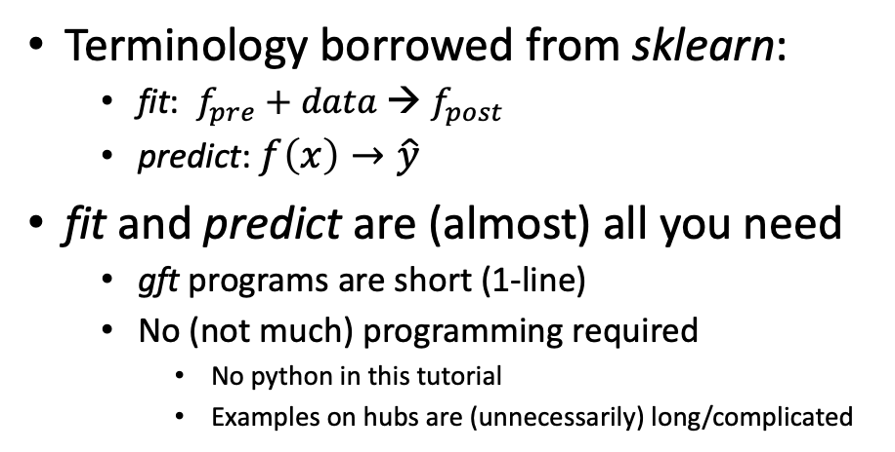
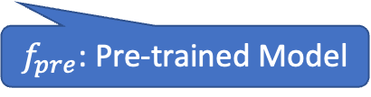

gft (general fine-tuning): A Little Language for Deep Nets (Unix Philosophy: Less is More)
Standard 3-Step Recipe
Examples of 1-line GFT Programs
Step 2: gft_fit
Data
$f_{pre}$: Pre-trained Model
Terminology borrowed from sklearn:
fit: $f_{pre}$ $+ data$→ $f_{post}$
predict: $f\left(x\right)→\hat{y}$
fit and predict are (almost) all you need
gft programs are short (1-line)
No (not much) programming required
No python in this tutorial
Examples on hubs are (unnecessarily) long/complicated
$f_{post}$: Post-trained Model
Step 3: gft_predict
$$x$$
$$\hat{y}$$
Score

Slide 4
Agenda
Syn/Ant Binary Classification
From Words to Texts
MWEs: Multiword Expressions
OOVs: Out of Vocabulary words
Multi-Lingual
Negation
Leakage with Standard Benchmarks
VAD Regression
VAD = Valance, Arousal, Dominance

Slide 5
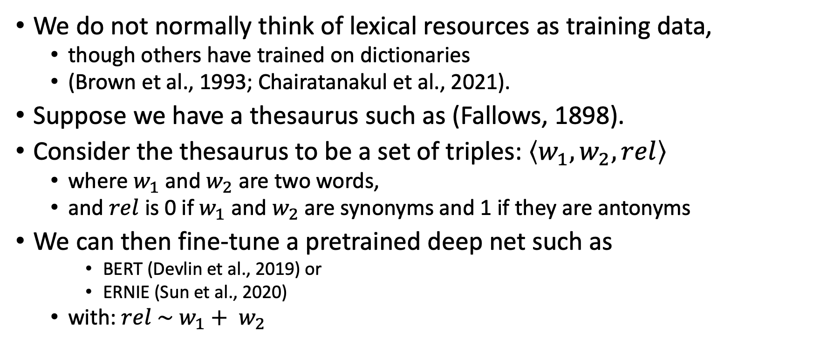
Training on Lexical Resources
We do not normally think of lexical resources as training data,
though others have trained on dictionaries
(Brown et al., 1993; Chairatanakul et al., 2021).
Suppose we have a thesaurus such as (Fallows, 1898).
Consider the thesaurus to be a set of triples: $\left\langle w_{1},w_{2},rel\right\rangle$
where $w_{1}$ and $w_{2}$ are two words,
and $rel$ is 0 if $w_{1}$ and $w_{2}$are synonyms and 1 if they are antonyms
We can then fine-tune a pretrained deep net such as
BERT (Devlin et al., 2019) or
ERNIE (Sun et al., 2020)
with: $rel \sim w_{1}+ w_{2}$

Slide 6
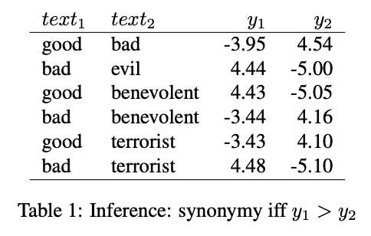
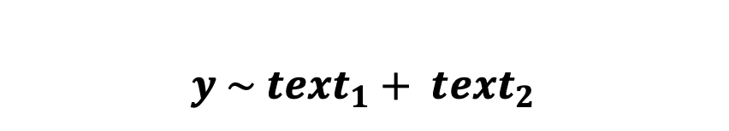
Training on Fallows Thesaurus
Training
(fit)
classify: gold ~ word1 + word2
$$y \sim {text}_{1}+ {text}_{2}$$
Inference
(predict)
0 → Synonym
1 → Antonym
word1 | word2 | gold
ancient | oldfashioned | 0
blame | disapprove | 0
clearly | confusedly | 1
debt | liability | 0
demure | modest | 0
profitable | fruitless | 1
revelry | orgies | 0
rotation | order | 0
vanity | selfdistrust | 1
Data from Fallows (1898)

Slide 7
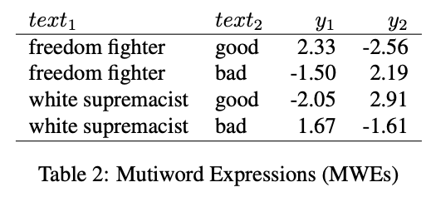
From Words to Text (MWEs: Multiword Expressions)
Inference on Words
Inference on Texts (MWEs)

Slide 8
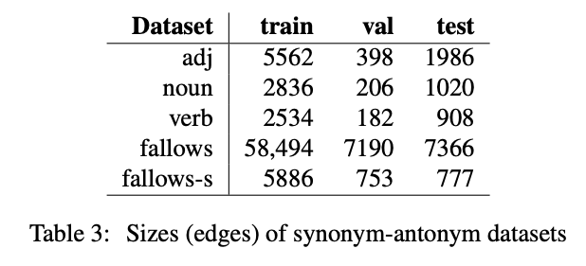
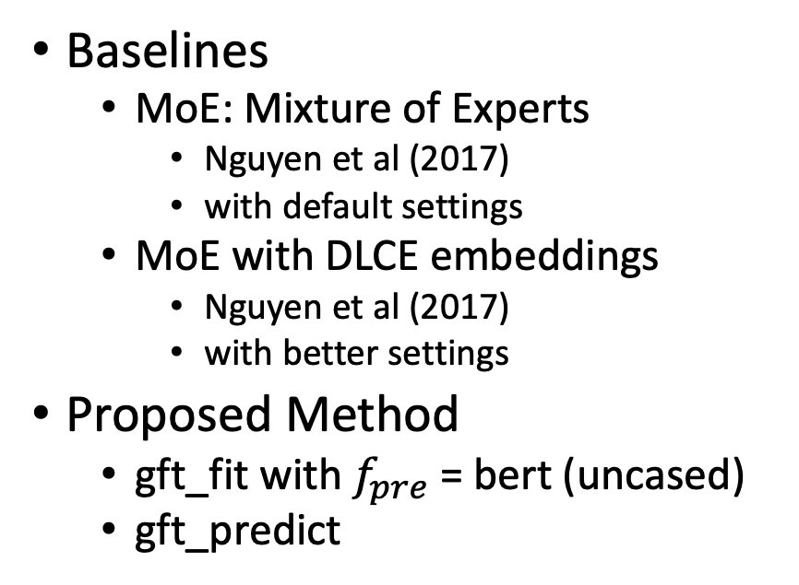
Methods
Methods
Datasets
Baselines
MoE: Mixture of Experts
Nguyen et al (2017)
with default settings
MoE with DLCE embeddings
Nguyen et al (2017)
with better settings
Proposed Method
gft_fit with $f_{pre}$ = bert (uncased)
gft_predict
Fallows (1898)

Slide 9
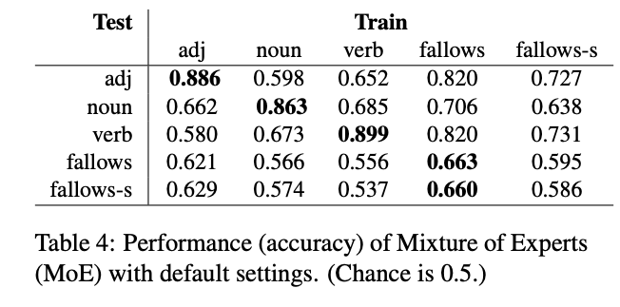
Baseline Results (MoE with default settings)
Sizes of 5 Datasets
Train on Dataset[i]; Test on Dataset[j]
Nguyen et al (2017) report results for 3 of 25 cases
Exception to Diagonal

Slide 10
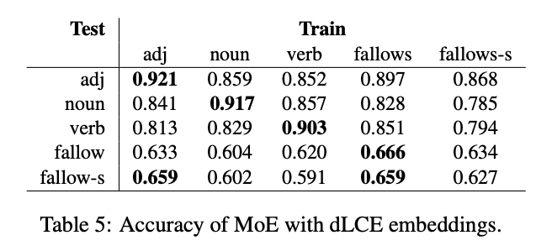
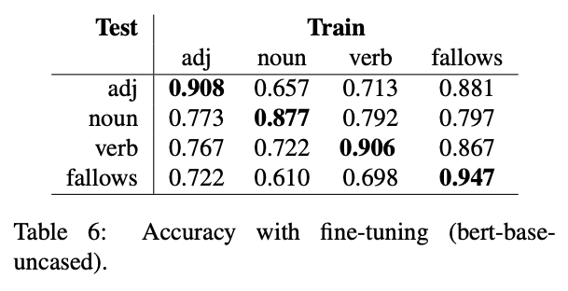
More Results
MoE with better settings
Proposed: Fine-Tuning

Slide 11
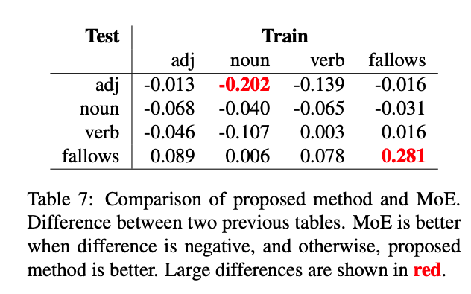
Proposed is better on Fallows Baseline is slightly better on datasets it was designed for
Delta (Proposed – MoE)
Proposed: Fine-Tuning

Slide 12
Agenda
Syn/Ant Binary Classification
From Words to Texts
MWEs: Multiword Expressions
OOVs: Out of Vocabulary words
Multi-Lingual
Negation
Leakage with Standard Benchmarks
VAD Regression
VAD = Valance, Arousal, Dominance

Slide 13
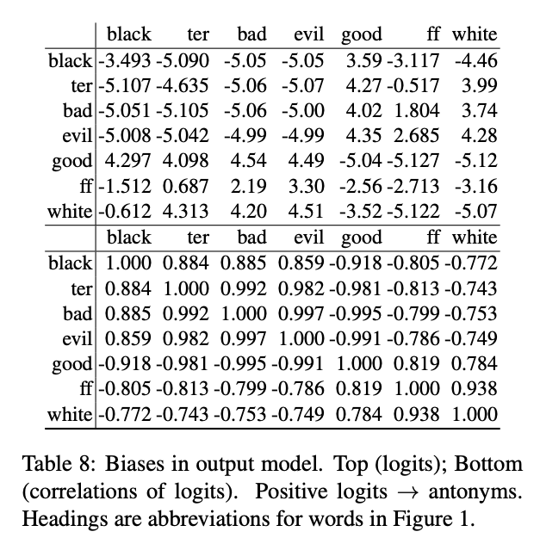
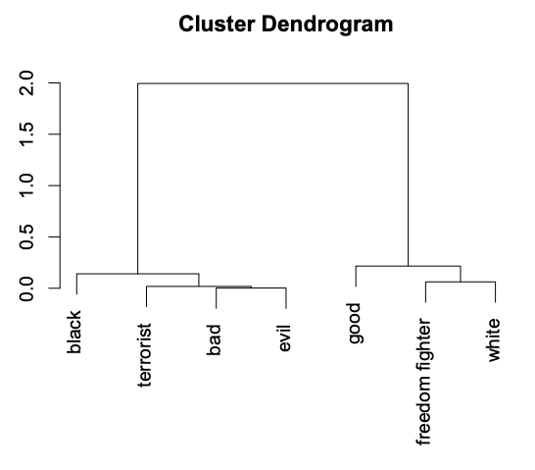
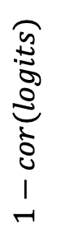
From Words to Text (Undesirable Biases)
Logits (top); Cor of Logits (bottom)
Clustering of Cor of Logits
$$1−cor(logits)$$

Slide 14
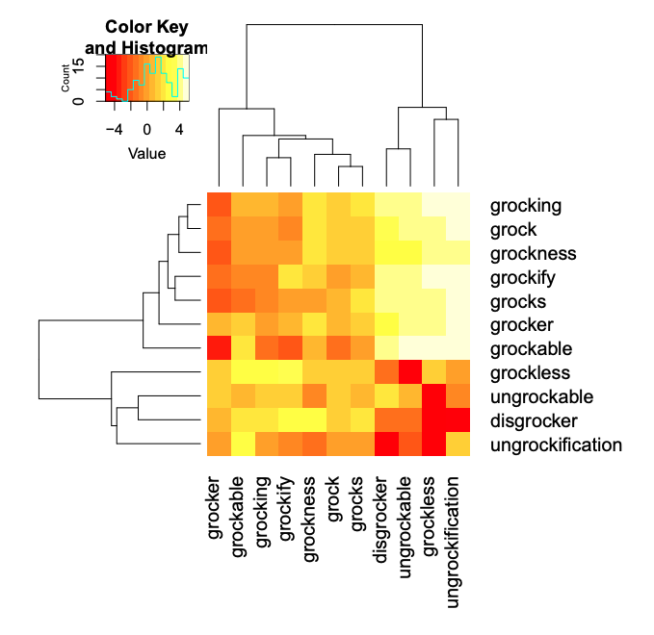
From Words to Text (OOVs: Out of Vocabulary)

Slide 15
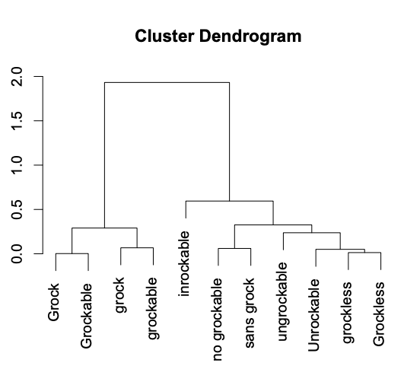
From Words to Text (OOVs: Out of Vocabulary)
Google Translations of Variants of Grock

Slide 16
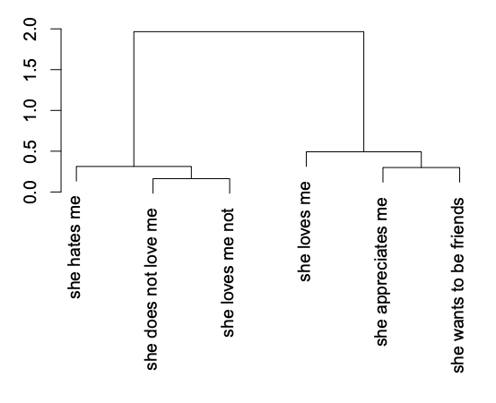
From Words to Text (Negation)

Slide 17
Agenda
Syn/Ant Binary Classification
From Words to Texts
MWEs: Multiword Expressions
OOVs: Out of Vocabulary words
Multi-Lingual
Negation
Leakage with Standard Benchmarks
VAD Regression
VAD = Valance, Arousal, Dominance

Slide 18
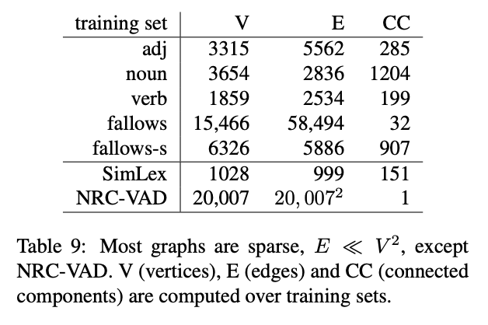
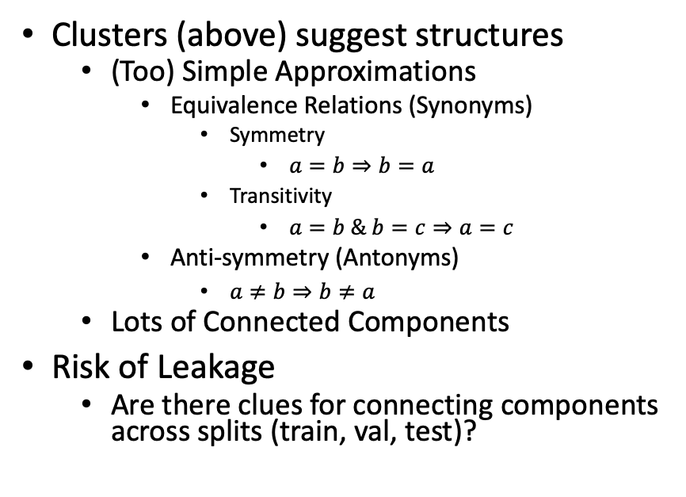
Concerns about Leakage
Most Graphs are Sparse
Concerns
Clusters (above) suggest structures
(Too) Simple Approximations
Equivalence Relations (Synonyms)
Symmetry
$a=b⇒b=a$
Transitivity
$a=b \& b=c⇒a=c$
Anti-symmetry (Antonyms)
$a≠b⇒b≠a$
Lots of Connected Components
Risk of Leakage
Are there clues for connecting components across splits (train, val, test)?

Slide 19
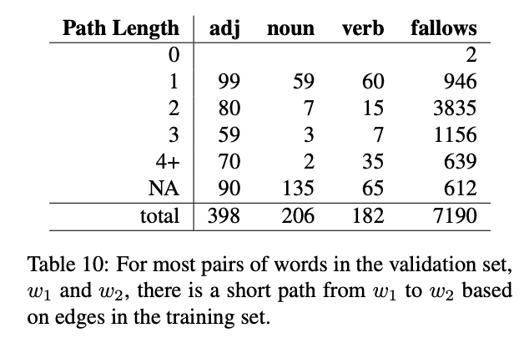
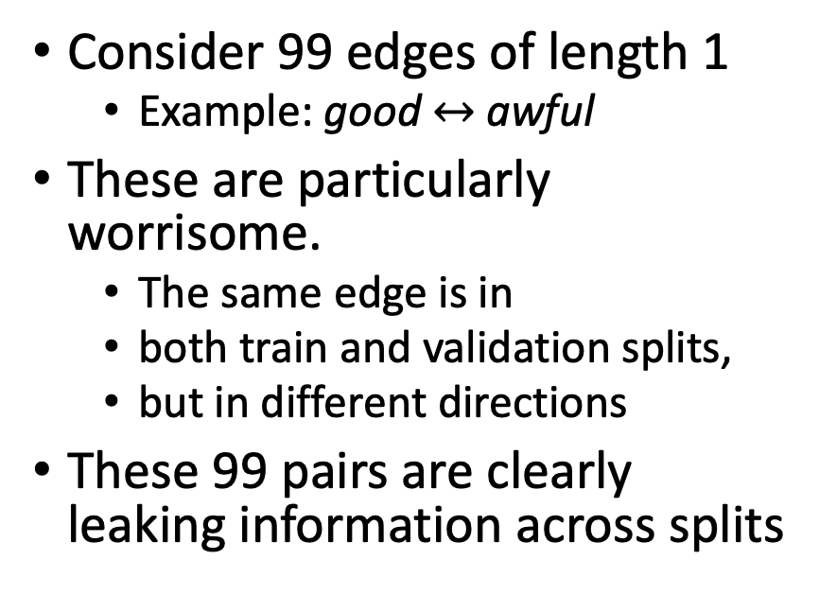
Evidence for Leakage
Paths of Length 1
Many Short Paths
Consider 99 edges of length 1
Example: good $↔$ awful
These are particularly worrisome.
The same edge is in
both train and validation splits,
but in different directions
These 99 pairs are clearly leaking information across splits

Slide 20
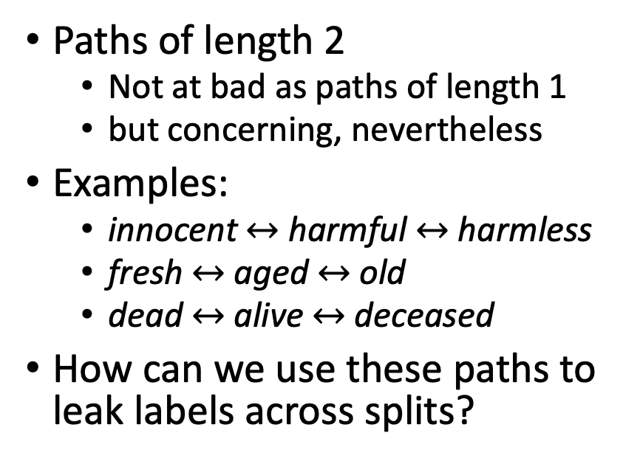
Evidence for Leakage
Paths of Length 2
Many Short Paths
Paths of length 2
Not at bad as paths of length 1
but concerning, nevertheless
Examples:
innocent $↔$ harmful $↔$ harmless
fresh $↔$ aged $↔$ old
dead $↔$ alive $↔$ deceased
How can we use these paths to leak labels across splits?

Slide 21
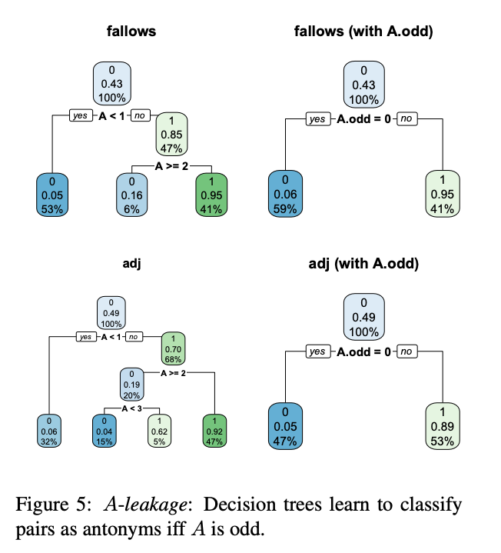
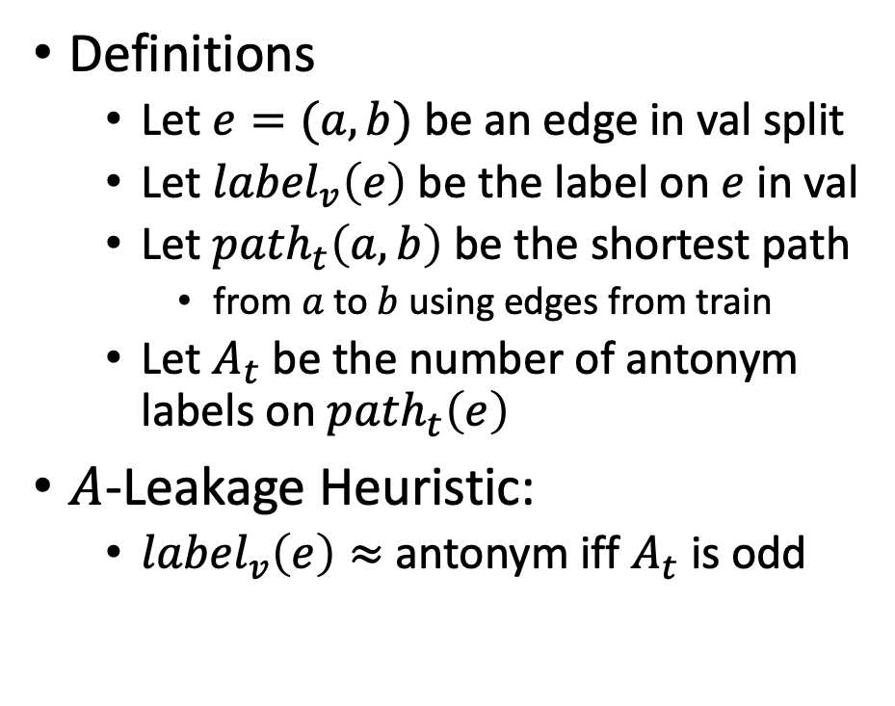
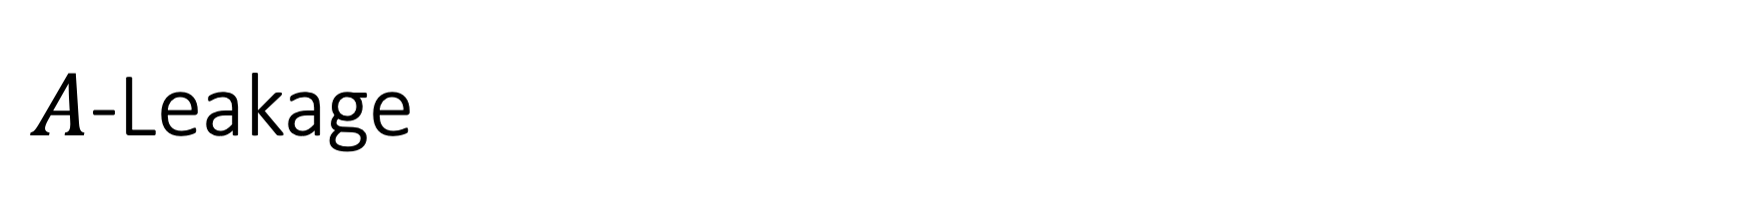
$A$-Leakage
Definitions
Let $e=(a,b)$ be an edge in val split
Let ${label}_{v}\left(e\right)$ be the label on $e$ in val
Let ${path}_{t}\left(a,b\right)$ be the shortest path
from $a$ to $b$ using edges from train
Let $A_{t}$ be the number of antonym labels on ${path}_{t}\left(e\right)$
$A$-Leakage Heuristic:
${label}_{v}\left(e\right)≈$ antonym iff $A_{t}$ is odd

Slide 22
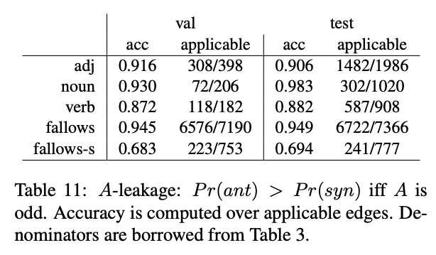
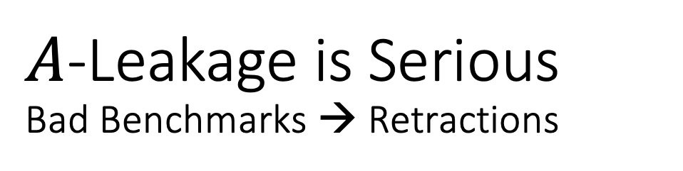
$A$-Leakage is Serious Bad Benchmarks → Retractions

Slide 23
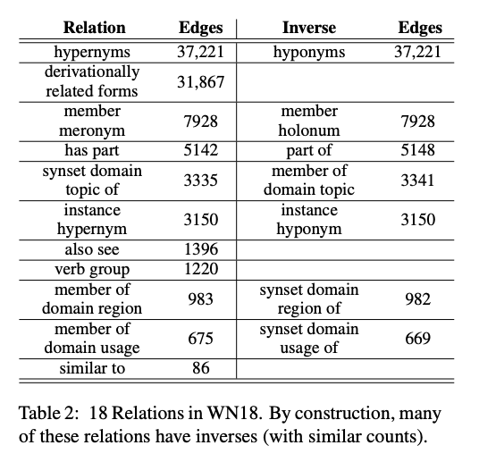
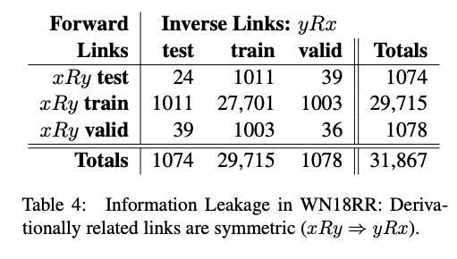
So Many Bad Benchmarks… So Few Retractions Church & Bian (EMNLP-2021)
WN18 → WN18RR
WN18RR

Slide 24
Agenda
Syn/Ant Binary Classification
From Words to Texts
MWEs: Multiword Expressions
OOVs: Out of Vocabulary words
Multi-Lingual
Negation
Leakage with Standard Benchmarks
VAD Regression
VAD = Valance, Arousal, Dominance

Slide 25
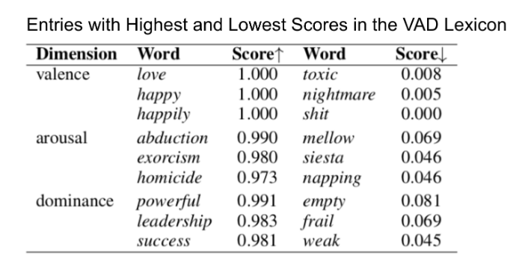
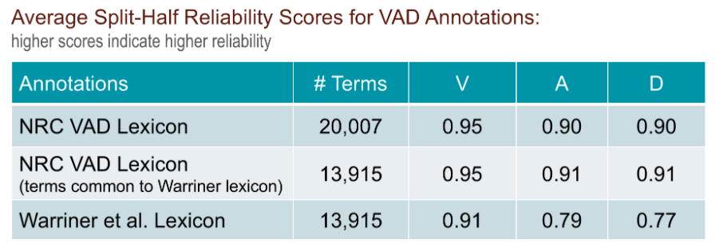
Another Example of a Lexical Resource: VAD https://saifmohammad.com/WebPages/nrc-vad.html
History in Psycholinguistics: (Osgood et al., 1957; Russell, 1980, 2003)
Valence: positive-negative or pleasure-displeasure
Arousal: excited-calm or active--passive
Dominance: powerful-weak or have full control-have no control

Slide 26
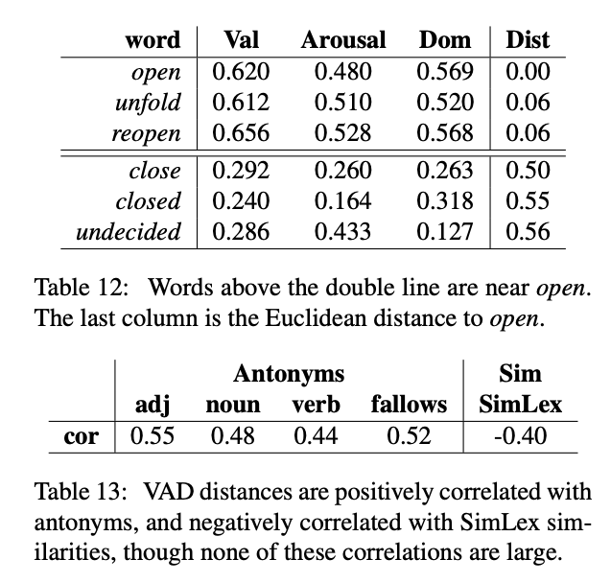
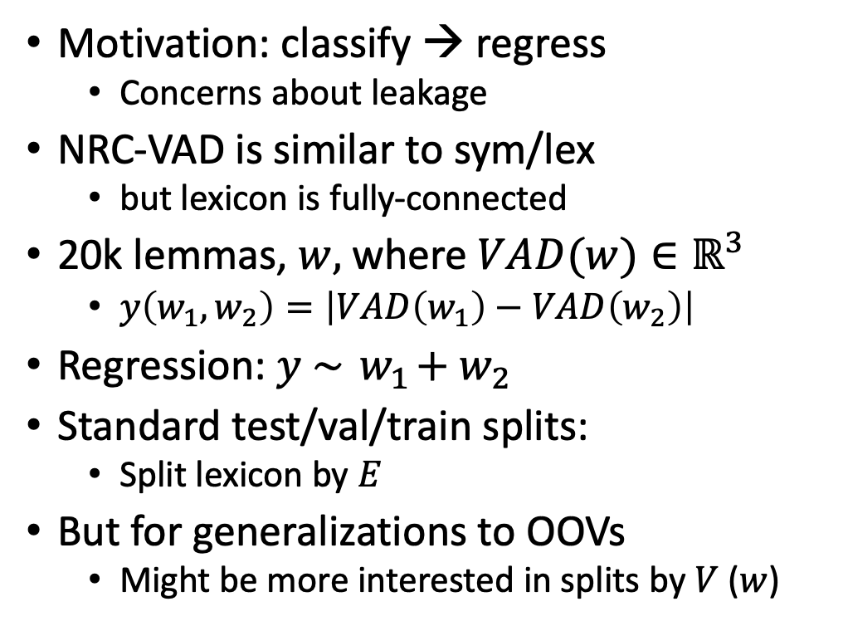
Syn/Ant Classification → VAD Regression
Motivation: classify → regress
Concerns about leakage
NRC-VAD is similar to sym/lex
but lexicon is fully-connected
20k lemmas, $w,$where $VAD(w)∈ℝ^{3}$
$y\left(w_{1},w_{2}\right)=\left|VAD\left(w_{1}\right)−VAD\left(w_{2}\right)\right|$
Regression: $y \sim { w}_{1}+w_{2}$
Standard test/val/train splits:
Split lexicon by $E$
But for generalizations to OOVs
Might be more interested in splits by $V$ ($w$)

Slide 27
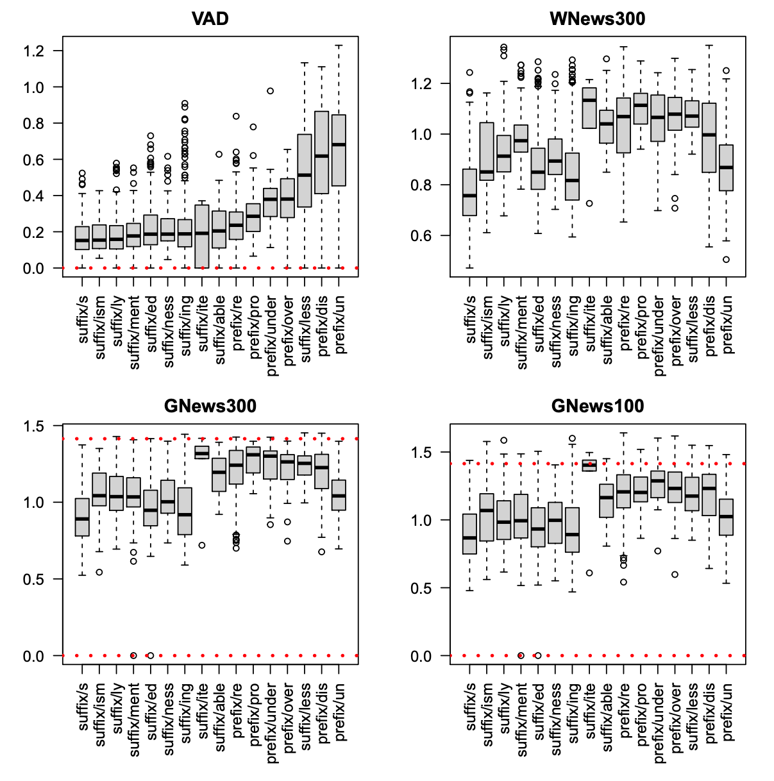
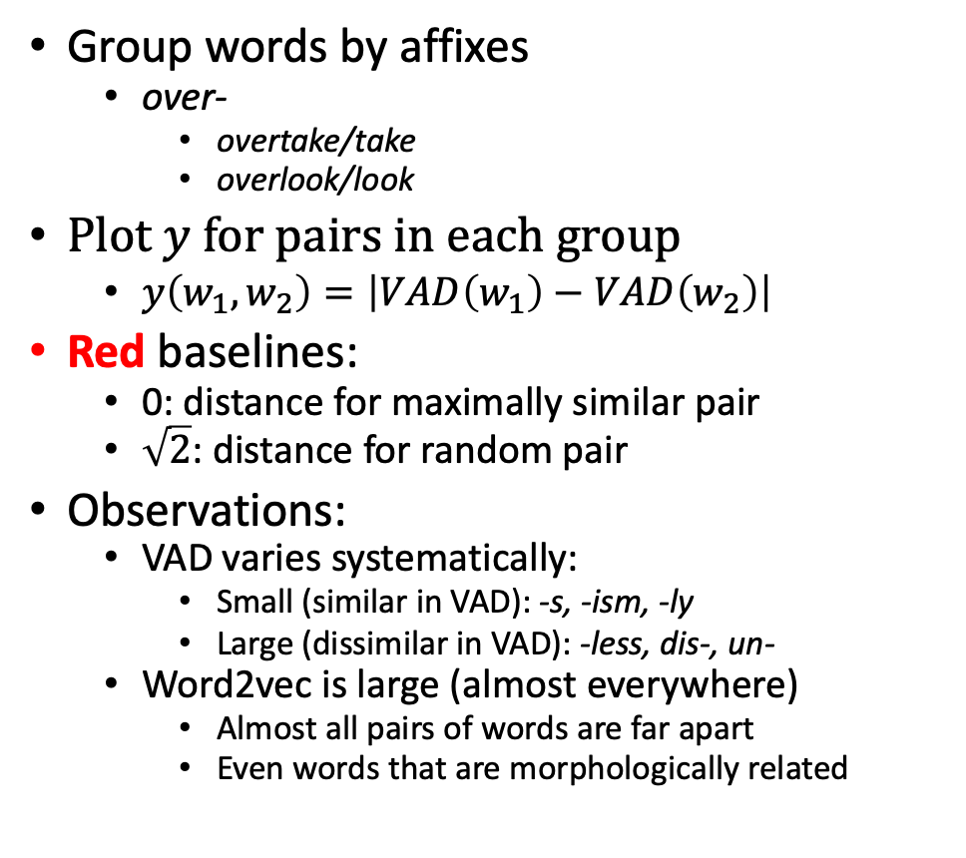
Morpheme Diagnostic
Group words by affixes
over-
overtake/take
overlook/look
Plot $y$ for pairs in each group
$y\left(w_{1},w_{2}\right)=\left|VAD\left(w_{1}\right)−VAD\left(w_{2}\right)\right|$
Red baselines:
0: distance for maximally similar pair
$\sqrt{2}$: distance for random pair
Observations:
VAD varies systematically:
Small (similar in VAD): -s, -ism, -ly
Large (dissimilar in VAD): -less, dis-, un-
Word2vec is large (almost everywhere)
Almost all pairs of words are far apart
Even words that are morphologically related

Slide 28
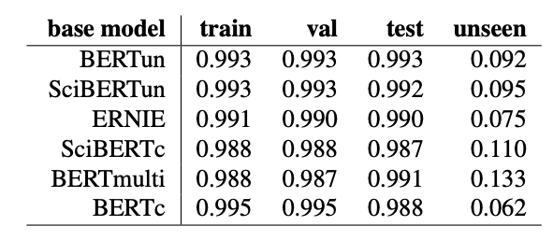
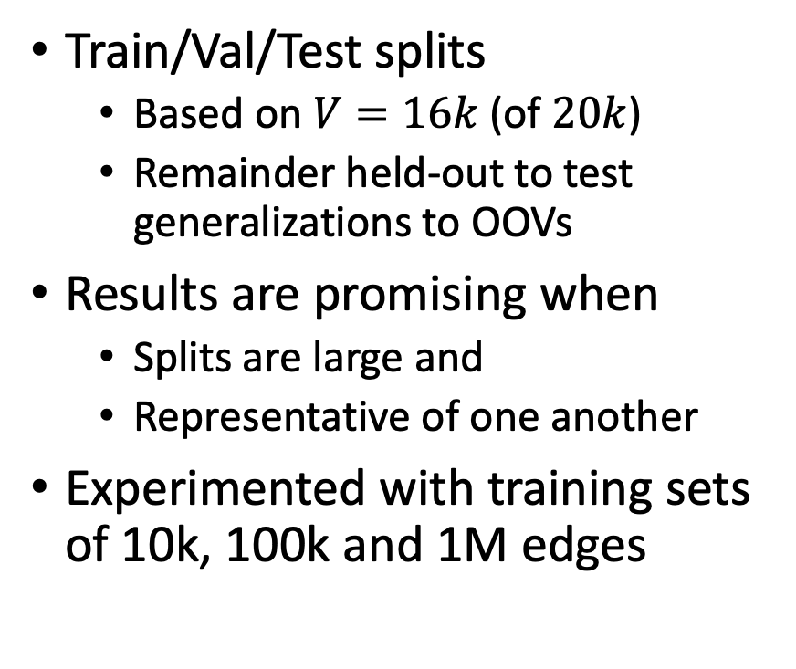
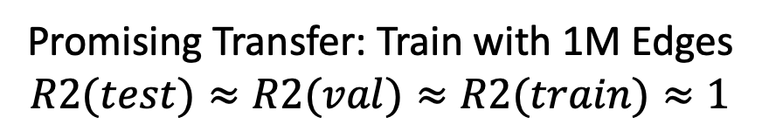
VAD Results (R2) R2 →1.0 (good); R2 → 0 (bad)
Train/Val/Test splits
Based on $V=16k$ (of $20k$)
Remainder held-out to test generalizations to OOVs
Results are promising when
Splits are large and
Representative of one another
Experimented with training sets of 10k, 100k and 1M edges
Promising Transfer: Train with 1M Edges
$$R2(test)≈R2(val)≈R2(train)≈1$$

Slide 29
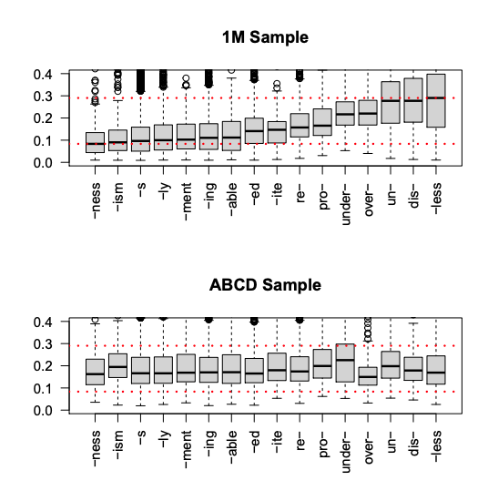
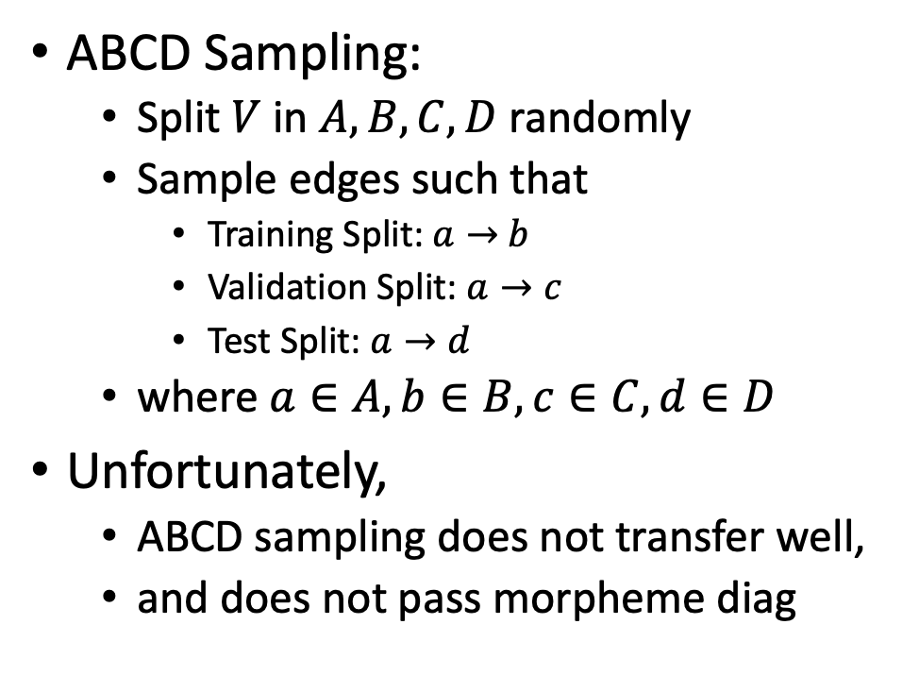
Morpheme Diagnostic (with ABCD Sampling)
ABCD Sampling:
Split $V$ in $A,B,C,D$ randomly
Sample edges such that
Training Split: $a→$ $b$
Validation Split: $a→c$
Test Split: $a→d$
where $a∈A, b∈B, c∈C, d∈D$
Unfortunately,
ABCD sampling does not transfer well,
and does not pass morpheme diag

Slide 30
Agenda
Syn/Ant Binary Classification
From Words to Texts
MWEs: Multiword Expressions
OOVs: Out of Vocabulary words
Multi-Lingual
Negation
Leakage with Standard Benchmarks
VAD Regression
VAD = Valance, Arousal, Dominance

Slide 31
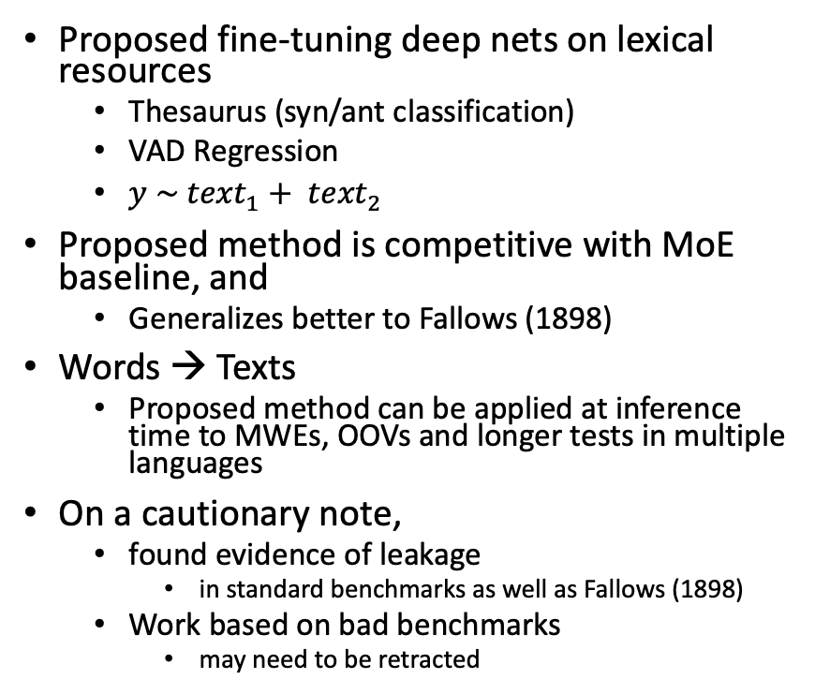
Conclusions
Proposed fine-tuning deep nets on lexical resources
Thesaurus (syn/ant classification)
VAD Regression
$y \sim {text}_{1}+ {text}_{2}$
Proposed method is competitive with MoE baseline, and
Generalizes better to Fallows (1898)
Words → Texts
Proposed method can be applied at inference time to MWEs, OOVs and longer tests in multiple languages
On a cautionary note,
found evidence of leakage
in standard benchmarks as well as Fallows (1898)
Work based on bad benchmarks
may need to be retracted
To address concerns with leakage,
we introduced a new task: VAD regression
Since VAD is fully-connected,
we could study sampling methods
Transfer is more effective
when splits are large
and representative of one another
In such cases,
reduces training loss (in fine-tuning)
also reduces loss on other splits
Proposed method:
effective for pairs of words in training set
but less so for pairs of unseen words

